Slide 1

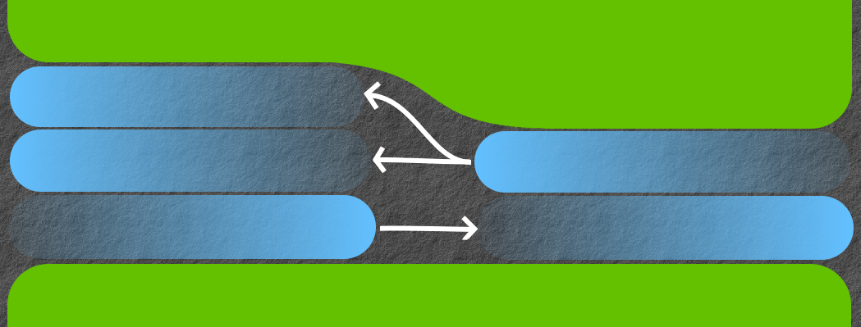
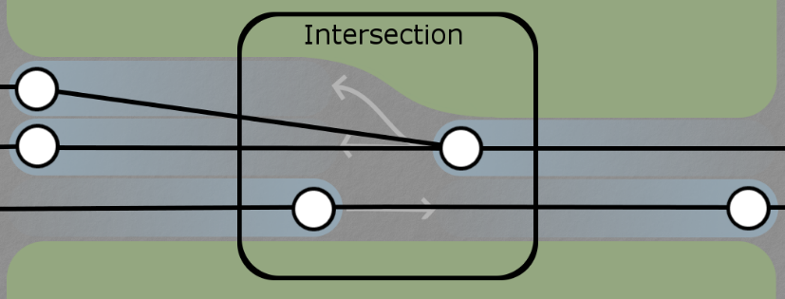
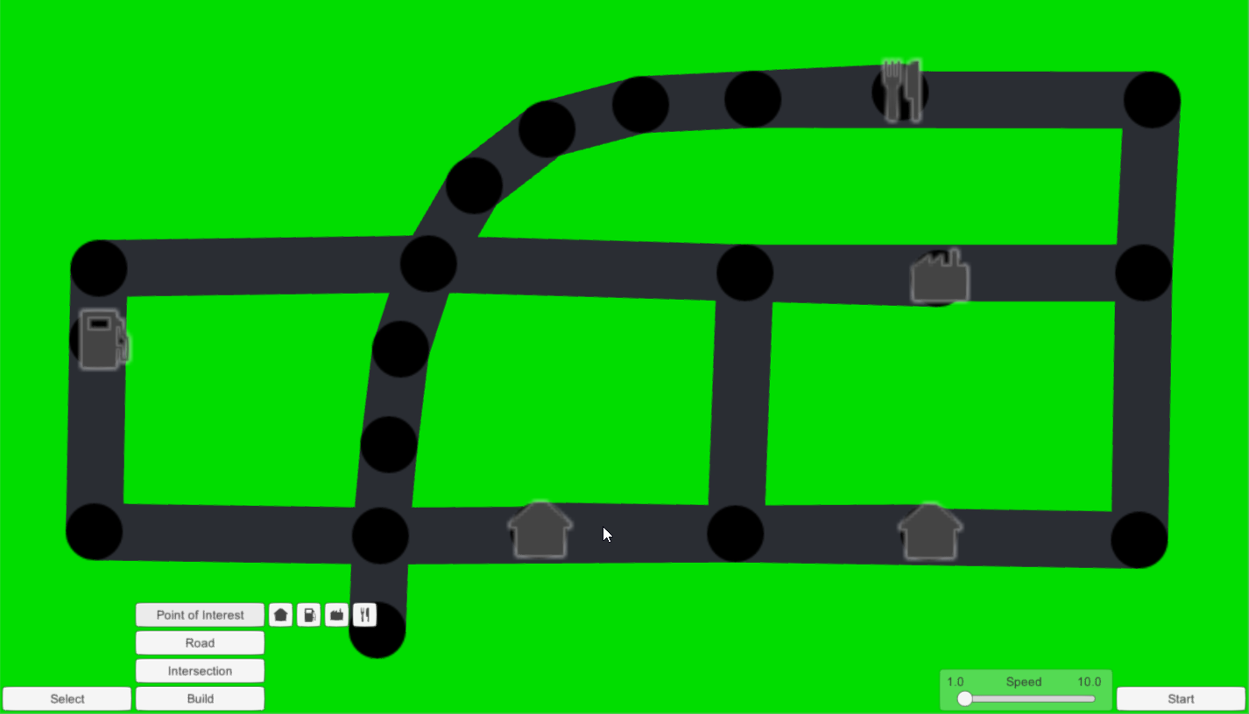
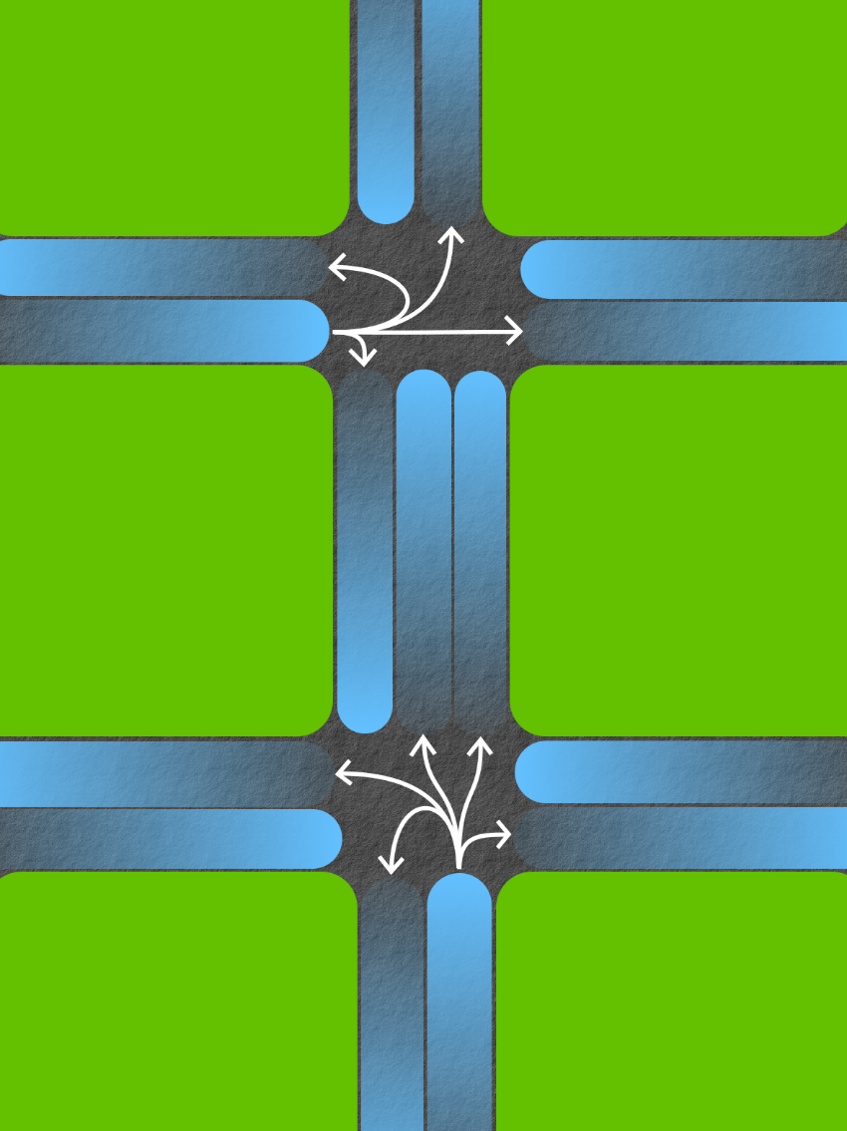
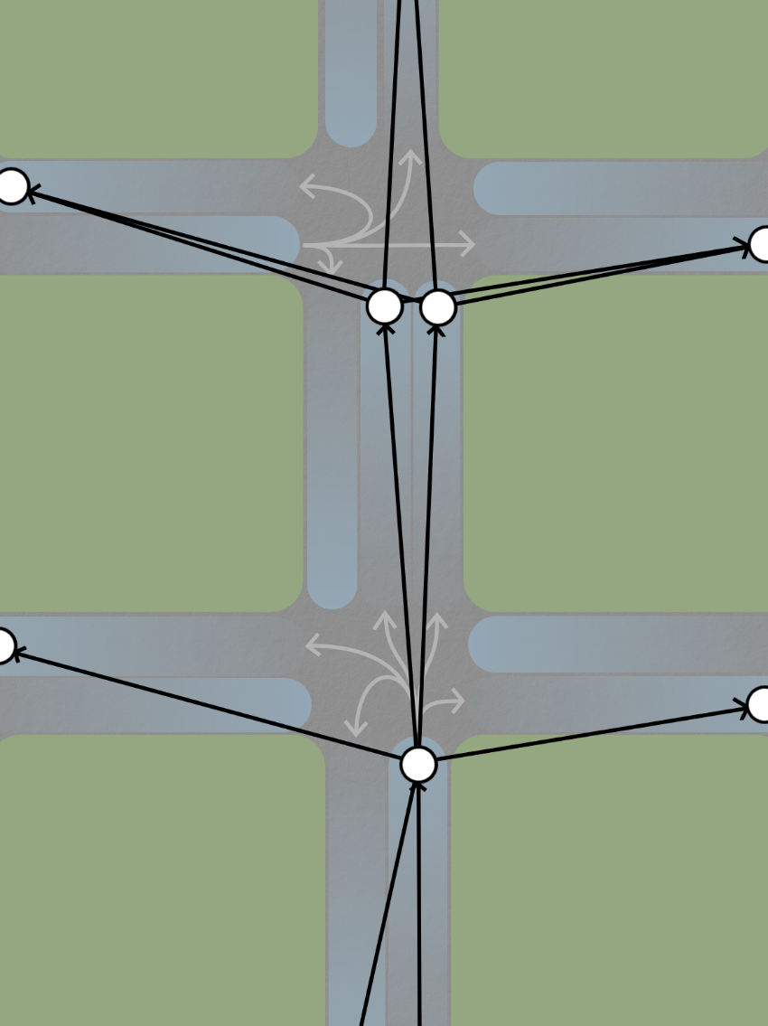
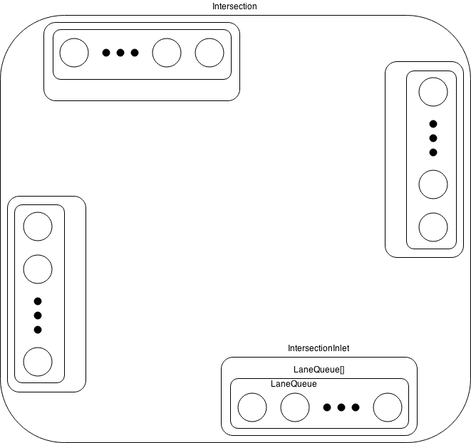
Street Network Performance Analysis Through Simulation
By Nick Powers, and Jordan White
CS 4491 - Dr. Jose Garrido
Vehicle Navigation
A routing algorithm was developed to help vehicles navigate the graph of LaneQueues. Storing the street network as a directed graph allows us to use the Bellman Ford algorithm to compute the minimum cost between every two nodes. Using that information a next-hop matrix is constructed where each element represents the adjacent node to travel to from any given node.
To construct the next-hop matrix the cost to get to the destination of every adjacent node is sorted. The node can then be prioritized by the position their cost has in the sorted cost values. By storing more than just one next-hop matrix vehicles can take detours in situations of deadlock.
The reference to the destination LaneQueue is automatically acquired when querying the optimal next-hop to take given the start and destination.
Since most nodes within the graph are not final destinations the next-hop matrix is allowed to contain null columns. This saves a large amount of space since there are multiple next-hop matrices stored throughout the duration of the simulation.
Project Overview
A traffic simulation can be used to design street networks that are efficient and provide sufficient capacity in certain scenarios. Important statistical information such as trip time between two points of interest and speed along certain roadways are useful when deciding how to improve an existing design.
The following is an overview of the development of a process-based traffic simulation which includes devising a routing algorithm to help vehicles find their destination, and cooperative multi-threaded software.
Street Network
The street network is represented by multiple levels of graphs. The highest level is a directed graph where intersections are nodes and roadways are edges. The second level graph represents lanes where nodes are the lane body or LaneQueue and edges are the paths vehicles can take to transfer to another lane. A multi-lane roadway would therefore consist of multiple nodes. We will later see how these graphs are constructed from a given roadway.
LaneQueues are passive objects that behave like a queue. Since vehicles have varying length the LaneQueue needs to store more information than a conventional queue such as the sum of all the vehicle lengths within the queue. Intersections use these objects to buffer vehicles before routing them to their next destination.
Intersection
Intersections are used in any part of the street network that involves a change in structure. Those include points where lane(s) are added or removed, intersections, and points of intersest. In cases where the intersection is a point of interest vehicles will be added or removed from the simulation. When the intersection is neither a point of interest nor a lane expansion it behaves as a normal intersection where street lights dictate the transferring of vehicles.
The intersection object is ran by a thread. This requires that LaneQueues that enter the intersection be locked before using. The destination LaneQueue must be locked as well to prevent race conditions. To prevent deadlock of the simulation in situations where the LaneQueue graph consists of circular paths, vehicles are dequeued from the source laneQueue and stored temporarily to unlock the source queue.
Intersection Structure
The intersection contains an array of four nullable IntersectionInlets. In cases where the intersection is a 3-way intersection one of the elements in the inlet array are null. Depending on the state of the street lights at the intersection vehicles are transferred from an inlet to an adjacent intersections inlet.
Simulation Results
Statistical information about average wait time will be recorded for each intersection. When the simulation is stopped the user will be able to observe the data through the GUI constructed using the Unity3d engine.
Points of interest will provide statistical information about the average trip time between them and their respective destination points of interest. This information is presented as a labeled graph where the directed edges represent the trip between both endpoints of the edge and the label will present the average trip time.

